Slide 1
AIRFRAME TEAM PROGRESS REPORT
O5/12/2023

Slide 2
OVERVIEW
Fabrication of fin alignment jig
Fibre Glass Tube Assembly
Parachute Fabrication
Completion of launchpad fabrication

Slide 3
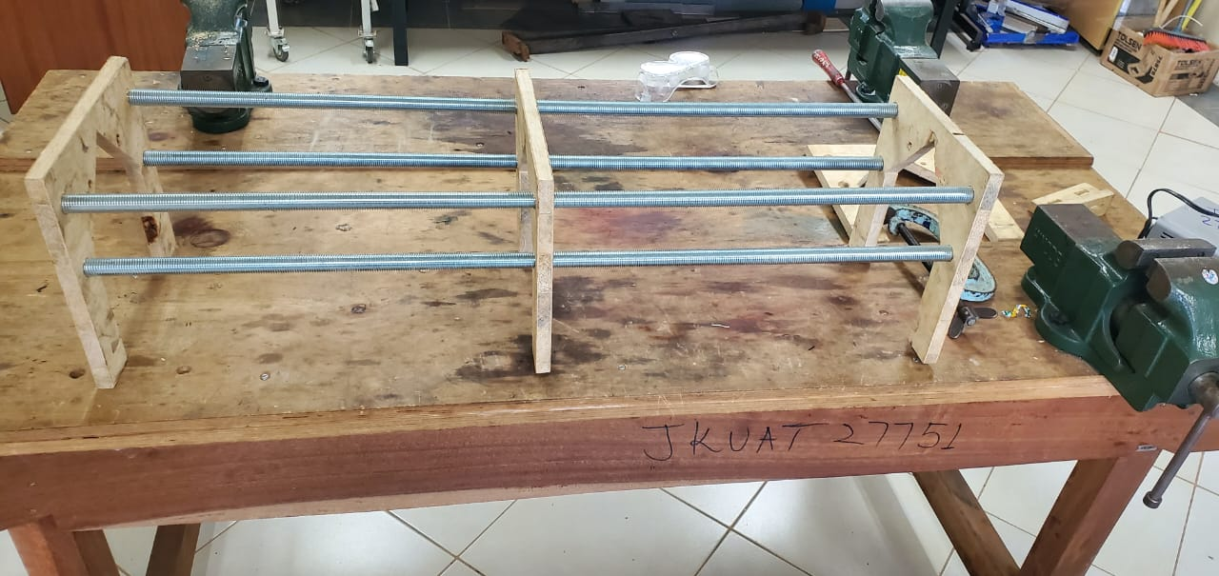
Fin Alignment Jig
Fabrication

Slide 4
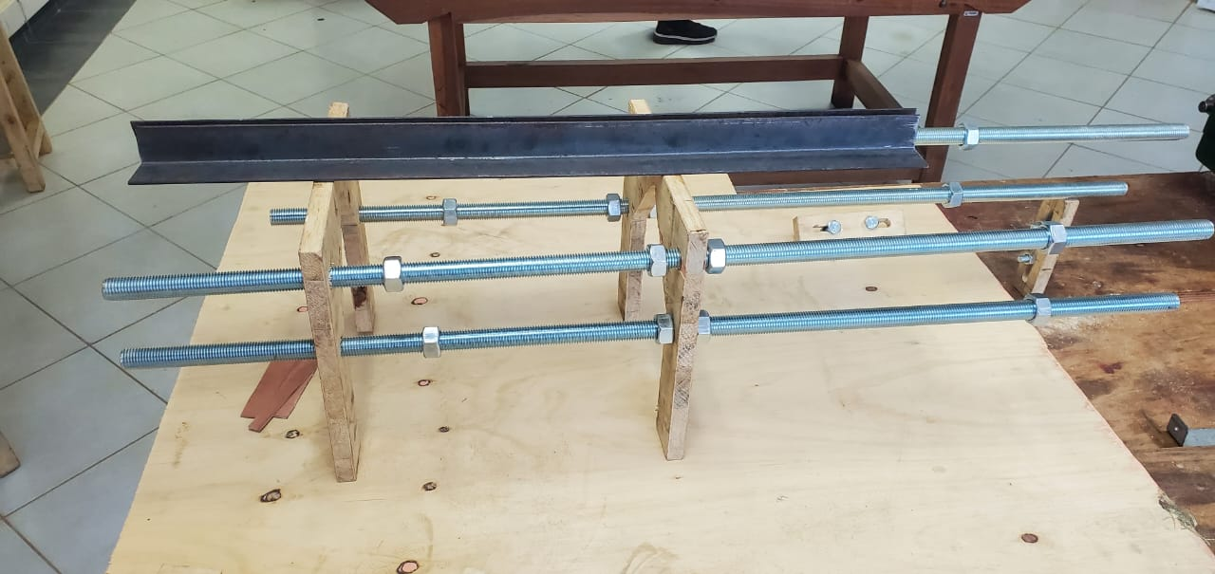
FIN JIG FABRICATION Cont’d
The metal angle plate provided was small (1.4m). Required (2.0m)
Redesign the position of the stands

Slide 5
Aluminium Sheet
Stalled since the rivets are yet to be acquired

Slide 6
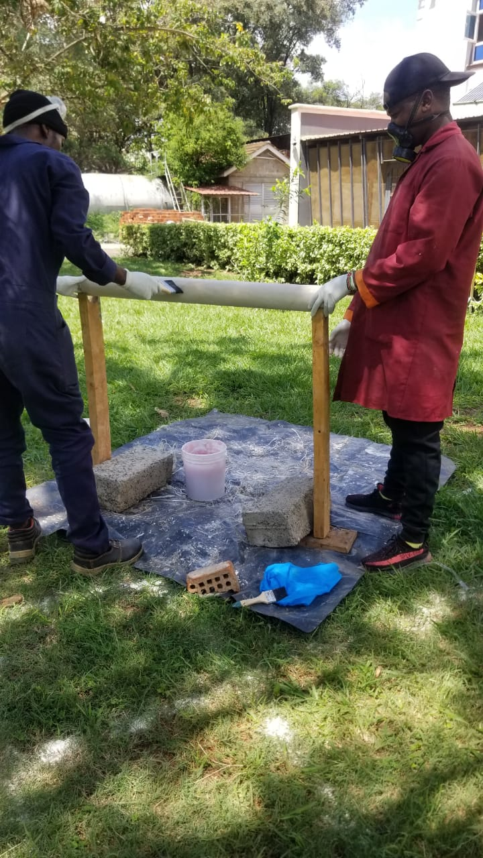
Fibreglass Tube
Gloss Painting of Second Tube
COMPLETE
Drying Phase

Slide 7
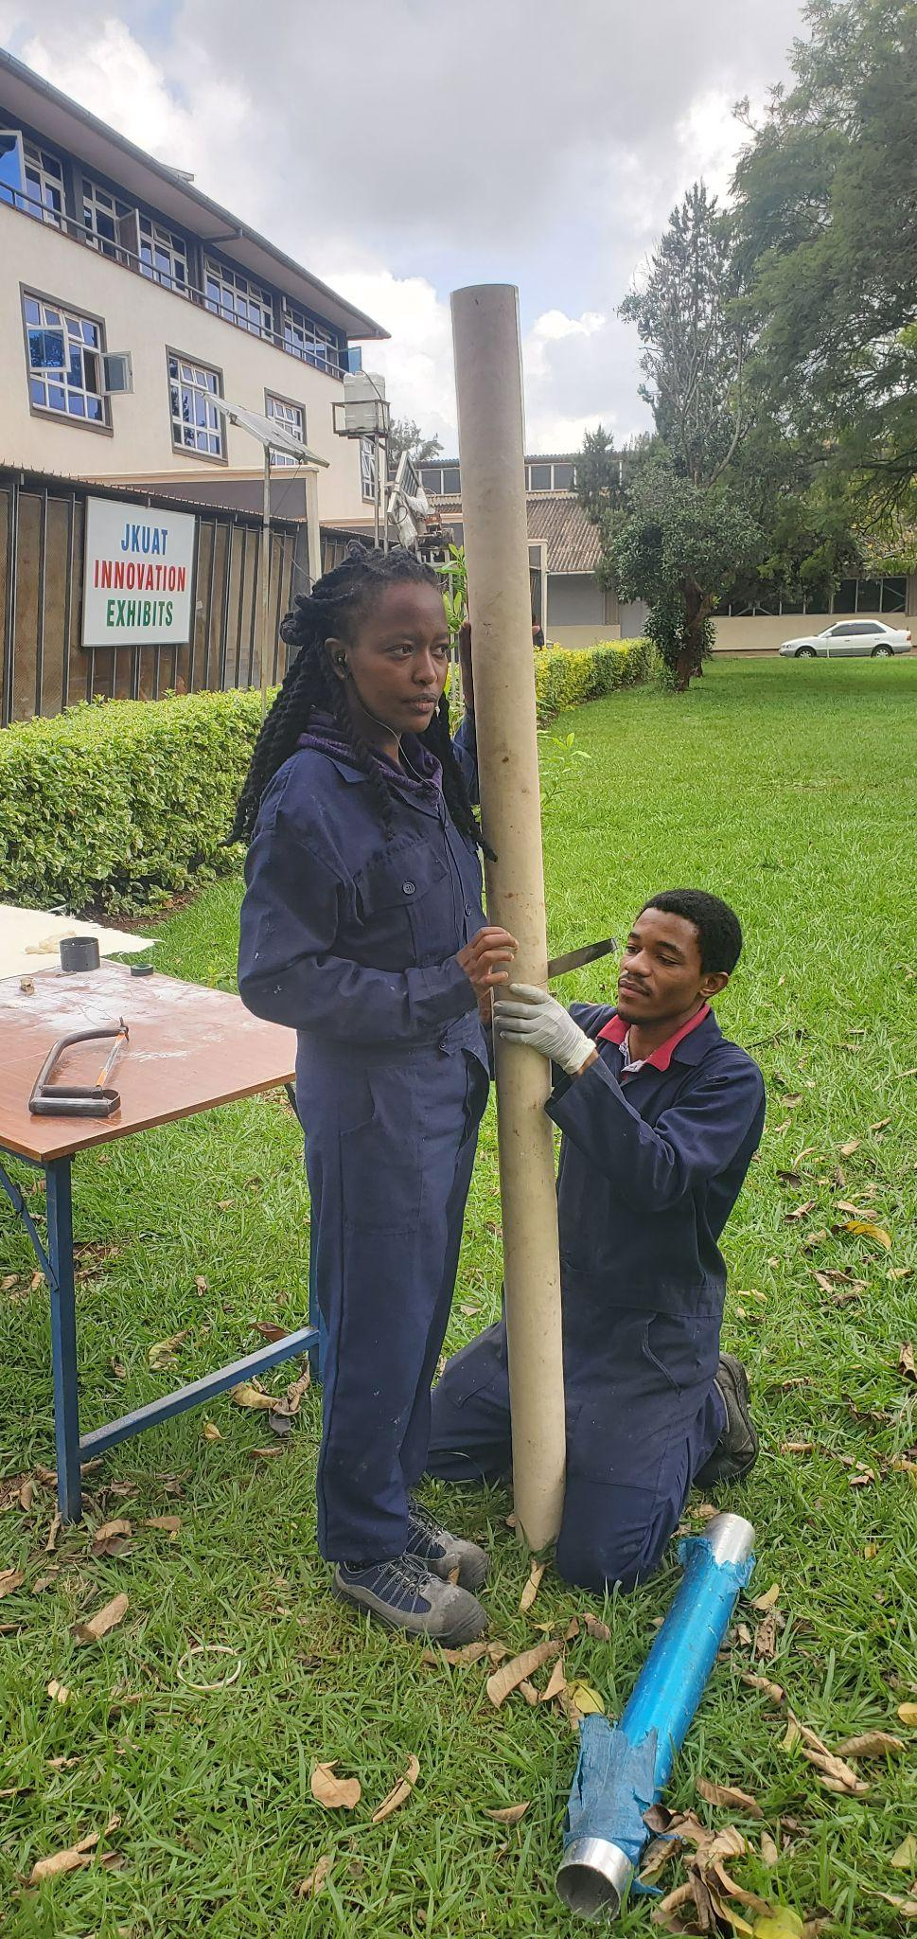
First Fibre Glass Tube Assembly
Coupled two fiberglass airframes.
The objective was to have a complete frame. However, the nose cone has not been printed. Operator was not available and couldn’t proceed on our own.
Fabrication of fin had to be postponed. The size of the required fin is dependant on overall size and weight, which at the moment couldn’t be established without factoring in avionics and propulsion payloads.

Slide 8
Parachute
Secured.
FABRICATION
Fabrication of parachutes is complete.
Need to test how effective they will be after successful deployment.
Intend to do a free-drop test, to measure the rate of descent which we hypothesis to be between 3.5m/s and 4.5m/s.
CHALLENGES.
Getting a high point/ building where we can do the test.
Need a dropping point of 12m or greater.

Slide 9
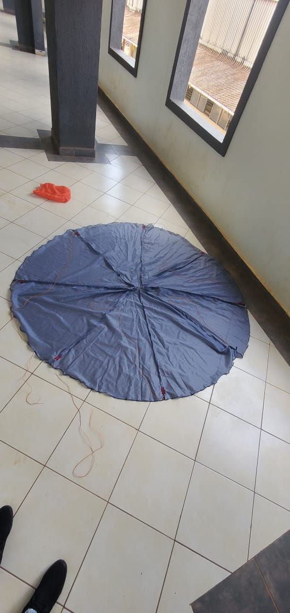
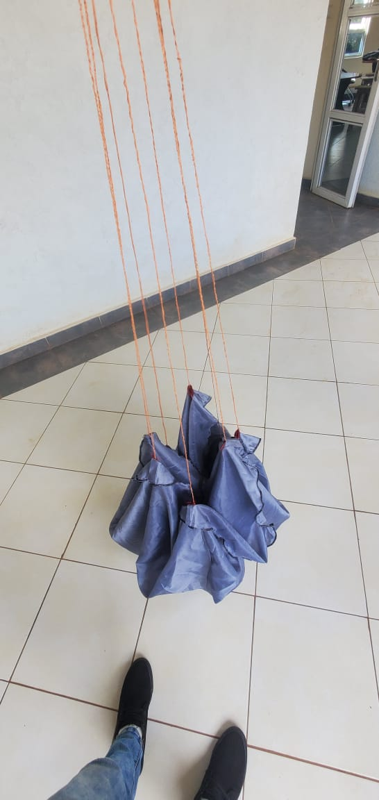
Parachute cont’d

Slide 10
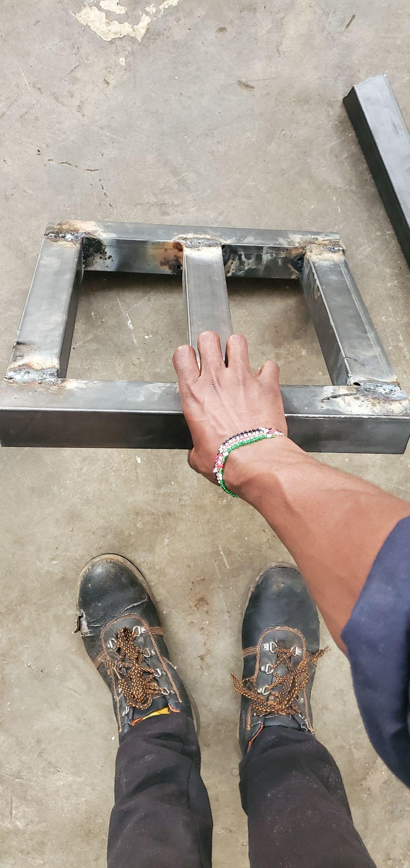
LAUNCH PAD (progress)
FABRICATION PROCESS
Acquired the necessary materials for the fabrication.
The fabrication is 50% complete.
CHALLENGES
We could not access the metal workshop for 2 days reason being it was undergoing repainting

Slide 11
NEXT WEEK’S OJECTIVES
Rolling of 1mm aluminium Sheet
Parachute Testing
3D Printing of atleast 3 nose cones
Assembly of Second Fibre Glass Tube
Conclusion of launch Pad Fabrication

Slide 12
THANK YOU.

